Slide 1

Facebook political ads
By Doug Torres
Data Analytics Cohort 1

Slide 2
motivation
Social media has influenced how the political discourse takes place and which information is advertised en masse.
Facebook is the largest platform for political ads so I will be looking into who is paying for these and how they decide to target people on the platform.

Slide 3

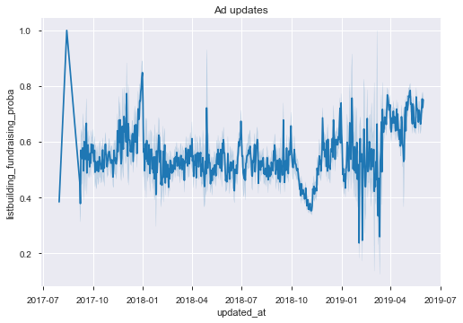
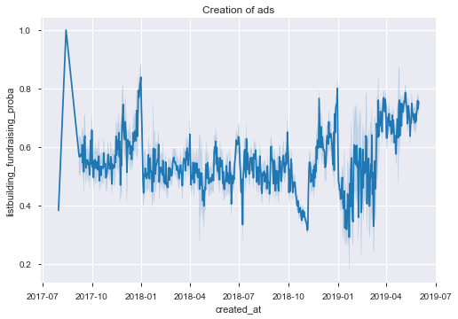
Setting the stage
The creation of ads follows the political campaigns as shown by the dropoff after the 2018 midterm elections and a ramp up for the 2020 presidential campaigns.

Slide 4
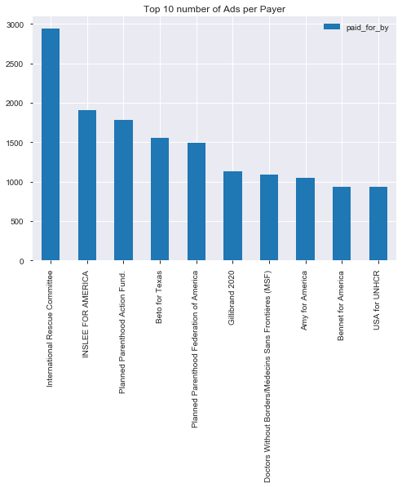
WHo are the payers
Payers who paid for the most ads on the platform.

Slide 5
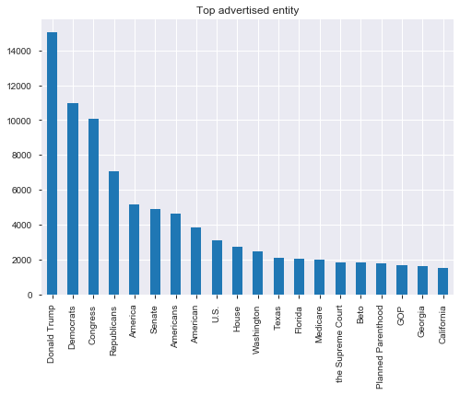
Who/what is getting the most attention?
Donald Trump and Beto O’Rourke where the most advertised individuals.
All other entities where groups/organizations.

Slide 6
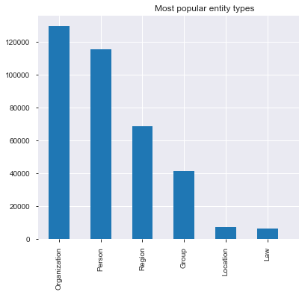
Orgs and People are the most advertised

Slide 7
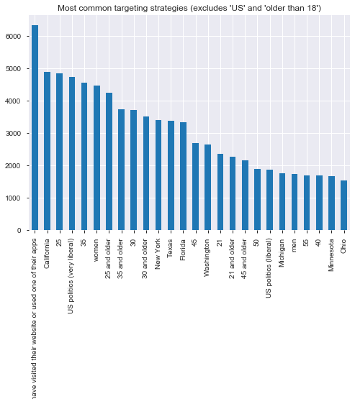
How are advertisers getting to you?
Excluding “18 or older” and “living in the US” targets, these are the most used ways to pinpoint the audience.

Slide 8
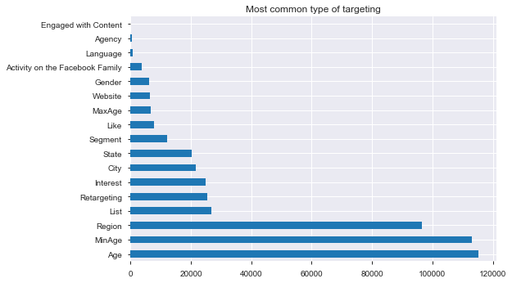
Most common targets
Age
Region
Interests

Slide 9
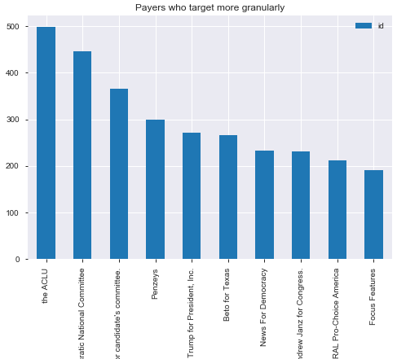
Priorities USA Action and SMP is the second highest observation.

Slide 10
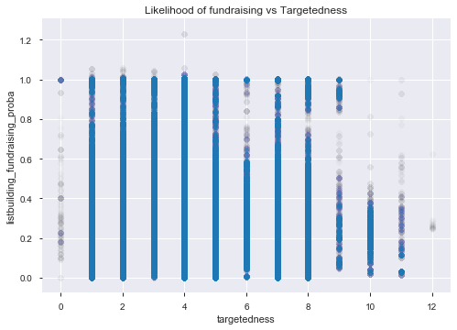
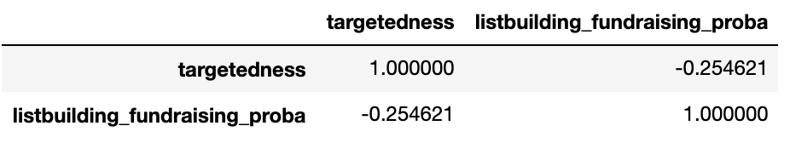
Data shows a decline in likelihood of fundraising as the ads get more granular.

Slide 11
Sources
The guardian: 'It might work too well': the dark art of political advertising online https://www.theguardian.com/technology/2018/mar/19/facebook-political-ads-social-media-history-online-democracy
Facebook political ads database: https://www.propublica.org/datastore/dataset/political-advertisements-from-facebook
Data is plural: https://tinyletter.com/data-is-plural/letters/data-is-plural-2016-11-16-edition

